Slide 1

Enabling SSL on DWP Catalog
Daniel Soto

Slide 2
Agenda
Creating SSL Certificate – SSL script
Configure native SSL on the BMC Digital Workplace Catalog server – Jetty
To establish a trust relationship between BMC Digital Workplace and BMC Digital Workplace Catalog
Configuring Enhanced Catalog Admin Section for SSL
Updating DWP Catalog on Remedy and SmartIT.
Notes:
I’m following the latest instructions on the docs for 19.02.
This should work for 19.00 and 18.00 versions, too.

Slide 3
Configure native SSL on the BMC Digital Workplace Catalog server - Jetty

Slide 4
HTTP (SSL) Implementation
RootCA (Certificate Authority): This is the entity that is allowed to sign any given certificate. This can be a public authority (internet) o a Domain server with that role (intranet)
Keystore: An storage created on the host to store certificates, when unsigned it’s considered a “Self Signed Certificate”
Certificate Chain: The file created by the RootCA that will sign the certificate inside the keystore.
TrustStore: Place to store the certificate authority information.

Slide 5
Official Documentation URL
https://docs.bmc.com/docs/display/dwpadvcurr/Configuring+access+to+the+BMC+Digital+Workplace+Catalog+server+over+SSL
We use SSL to secure our connections from one end to another and to protect sensitive data.

Slide 6



Config files that we need to edit
jetty-http.xml
<installLocation>/jetty/etc/jetty-http.xml
set_script_variables.sh
<installLocation>/sb/env/set_script_variables.sh
setenv.sh
<installLocation>/sb/rxscripts/bin/setenv.sh

Slide 7
From DWP 19.11 and beyond
Edit
/installLocation/bin/monitor.properties
And change current values to:
  https true
  arServerRestPort 8443

Slide 8
Update ar.conf to
Jetty-Port: 443
Jetty-Protocol: HTTPS

Slide 9
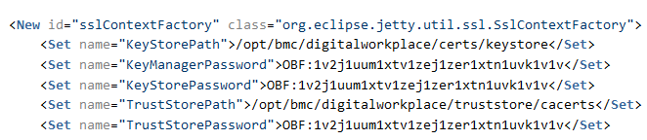
1) jetty-http.xml
<Set name="KeyStorePath">/opt/bmc/digitalworkplace/keystore.jks</Set>
<Set name="KeyManagerPassword">changeit</Set>
<Set name="KeyStorePassword">changeit</Set>
<Set name="TrustStorePath">/usr/java/jre1.8.0_181-amd64/lib/security/cacerts</Set>
<Set name="TrustStorePassword">changeit</Set>
<Set name="IncludeCipherSuites">
Before you continue…

Slide 10
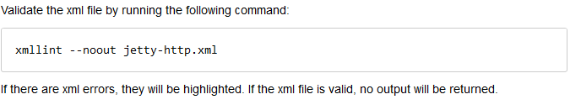
Validating xml files

Slide 11
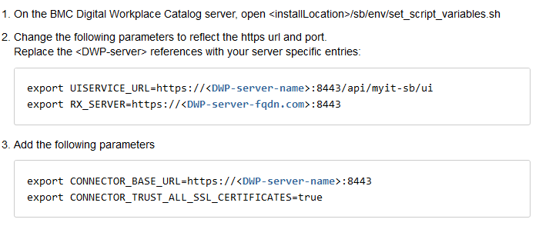
2) set_script_variables.sh
Modify these lines as below:
export UISERVICE_URL=https://clm-aus-ta8r7l:8443/api/myit-sb/ui
export RX_SERVER=https://clm-aus-ta8r7l.bmc.com:8443
Add this two lines
export CONNECTOR_BASE_URL=https://clm-aus-ta8r7l:8443
export CONNECTOR_TRUST_ALL_SSL_CERTIFICATES=true

Slide 12
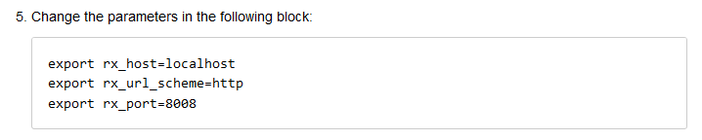
3) setenv.sh
export rx_host=clm-aus-013667.bmc.com
export rx_url_scheme=https
export rx_port=8443
Change these lines to:
export rx_host=clm-aus-ta8r7l.bmc.com
export rx_url_scheme=https
export rx_port=8443
export rx_trace="-k --trace-ascii ./trace.log"

Slide 13

EXTRA: Update user group sync script, too!
You will also need to update this script after configuring SSL – Refer to: To fix user synchronization issues
Script Location:
<installdirectory>/artools/user_group_sync.sh
Follow KA – 000133376 for this!!
https://communities.bmc.com/docs/DOC-61820

Slide 14

Allow Native SSL on the DWP Catalog Server
Go to <installLocation>/sb
Execute this command
  ./post_install.sh enable_insecure_sessions
Restart the DWP Catalog Server:
  ./dwpcontroller stop
  ./dwpcontroller start
Notes:
This is on 19.00 versions

Slide 15

You should be able to log onto the DWP Catalog using the HTTPS protocol and port (8443) now.
-If you get a Warning Message when hitting the DWP Catalog URL, it means, that you need to install the certificate on your local machine-
Tipically, these CA certificates are install by the Sysadmins over the Company Network.

Slide 16
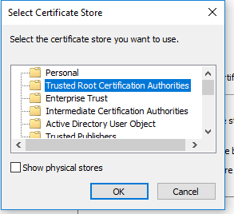
Installing CA Certificate on a Local Machine
-Download the CA file on your machine
-Right click on it
-Select Install certificate
-Select Local machine
-Click on ‘Place all certificates in…’
-Click on Browse
-Select
-Click on Next and the Finish.

Slide 17
To establish a trust relationship between BMC Digital Workplace and BMC Digital Workplace Catalog

Slide 18
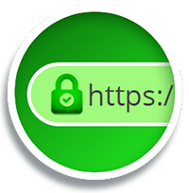
  Follow these steps:
  Go to the DWP Catalog page using the HTTPS url
  Click on the Green Lock
  Download the Certificate
  Upload the certificate to the DWP Advanced Server (FTP)
  Import the certificate to the DWP Advanced Java cacerts
  keytool -importcert -alias sbcert -keystore "<javapath>\jre1.8.0_91\lib\security\cacerts" -file SBCertforMyIT.crt
  Restart Tomcat

Slide 19
Extra
You need the .crt files from all the servers (AR, DWP, RSSO, SMARTIT), and import them all into the servers cacert files.

Slide 20
Configuring Enhanced Catalog Admin Section for SSL

Slide 21
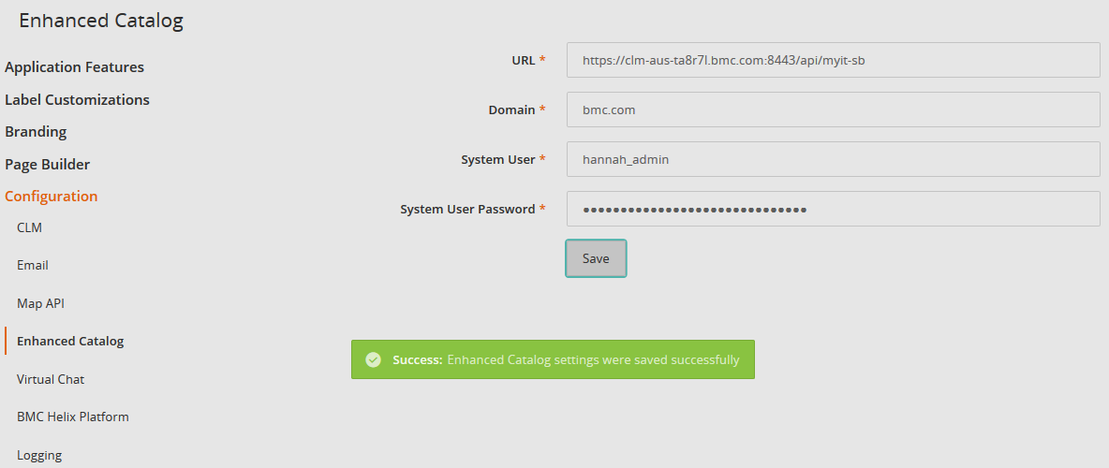
For this, you need to update the DWP Catalog URL in DWP Admin Console:
Go to http(s)://yourdwpserver:port/dwp/admin/configuration/sbe.html
Update the http to https and put the new port (8443/443)
Click on Save
Notes:
If you get a “623 Error” on this section, it means that your RSSO configuration is wrong/incomplete/not in place.
RSSO is mandatory.
443 can only be set by root.

Slide 22
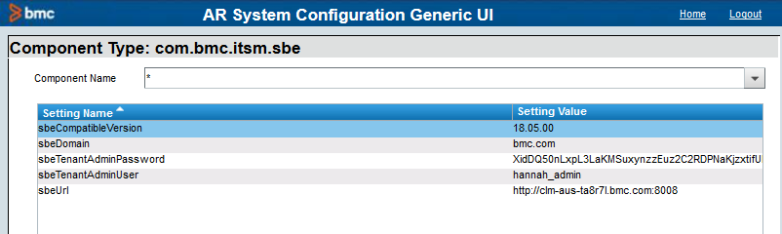
Update DWP C port for SmartIT integration
Where?
AR+System+Configuration+Generic+UI Form

Slide 23
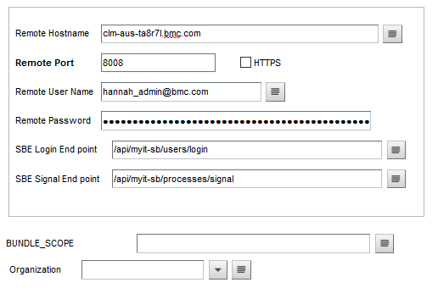
Update ITSM SB Forms Port
Where?
SB:RemoteApprovalConfiguration Form

